Slide 1
Early Childhood Intervention and Life-Cycle Skill Development: Evidence from Head Start
David Deming
Discussion by Jeff Denning

Slide 2
What is the question? Is it Interesting?
What’s the effect of Head Start on short, and long term outcomes?
Represents a substantial investment by the government which motivates study
Also, can be a way to mitigate inequality by family income

Slide 3
Background
Head Start is federal preschool program for poor children.
Started during the War on Poverty
Focuses on “whole child development”
Has income requirements

Slide 4
Data
NLSY 79--survey of youth between 14-22
Follow on looked at the children of the original NLSY participants in 1986
Required families with 2 children (why?)

Slide 5
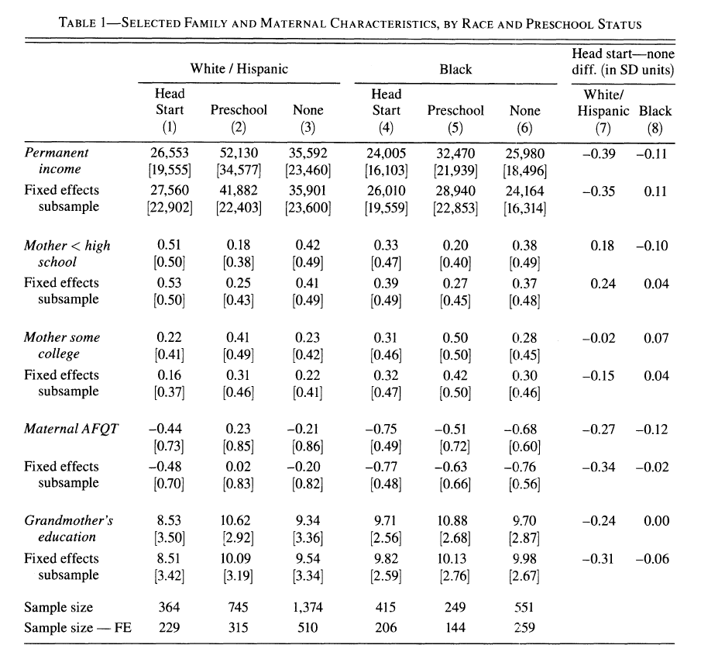

Slide 6
Outcomes
Considers early outcomes including test scores, grade retention, and disability diagnosis
Also considers HS graduation, college attendance, “idleness”, teen parenthood, health
BUT he generally looks at an index? Why?
(Multiple Inference)

Slide 7
Identification Strategy
Family fixed effects
This can be thought of as a type of matching
What is this equivalent to matching on?
For instance, you are matching on parent income, parent education, city, neighborhood, religion...everything common to a family
Can you control for family fixed effects and the race of the mother?

Slide 8
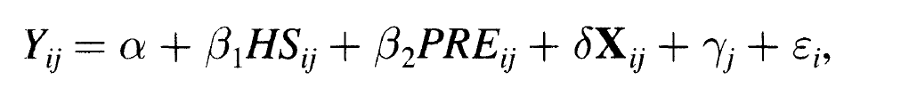
Estimating Equation

Slide 9
What assumption is necessary?
The author is very clear about what needs to be true for causal interpretation.
Within family, it needs to be as good as random which child attends Head Start
What would be a violation of this? What would not be?
What evidence does the author bring to bear on the validity of this assumption?

Slide 10
Indirect Evidence
85% of the population of head start centers are over subscribed
Fully subsidized

Slide 11
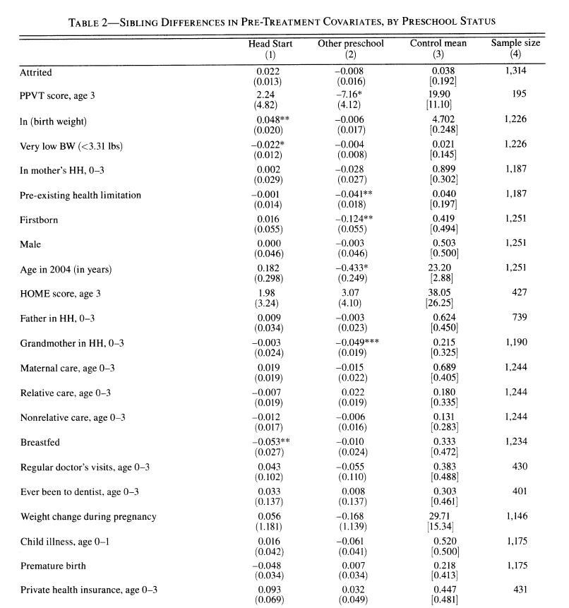

Slide 12
Results
Head Start has substantial impacts on both test scores and on long term outcomes
There is fade out of the test score gains. However, there are still long term benefits
This fadeout result is something that has appeared in other settings

Slide 13
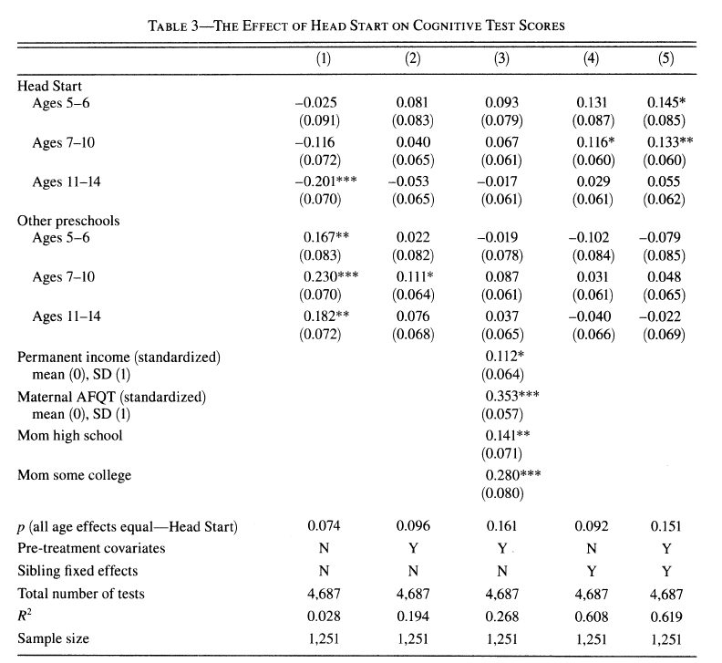

Slide 14
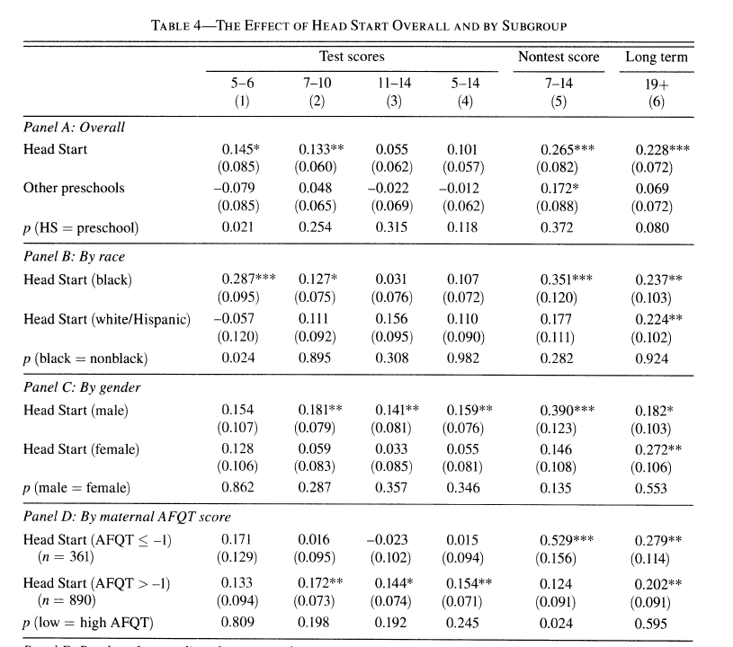

Slide 15
Conclusion
Matching requires assumptions about how treatment is assigned. May be more or less believable in some contexts.
Head Start has an effect on test scores that fades out. However, there are long term effects.

